Slide 1

Elements of Computing
Systems - II
Group
12
End Semester Project

Slide 2
Group members
MITHIN
CB.EN.U4AIE22132
CHARAN
CB.EN.U4AIE22119
1
2
CB.EN.U4AIE22135
CHARISH
CB.EN.U4AIE22156
VIKASH
4
3

Slide 3
PART A:
Implement the HACK computer in HDL and test it.
Refer the link Project 05 | nand2tetris to implement computer.hdl.
The computer.hdl has to be tested as per the instructions given in the above link by using any .hack file.
1
PART B:
Write a Jack program to implement a symbol table. Possible entries in a symbol table:
• Name : a string
• Attribute:
Reserved word
Variable name
Type Name
Procedure name
2
3
PART C:
As a part of this project each team, is expected to come up with a unique question.
The question should be related to the topics taught in Elements of Computing-2

Slide 4
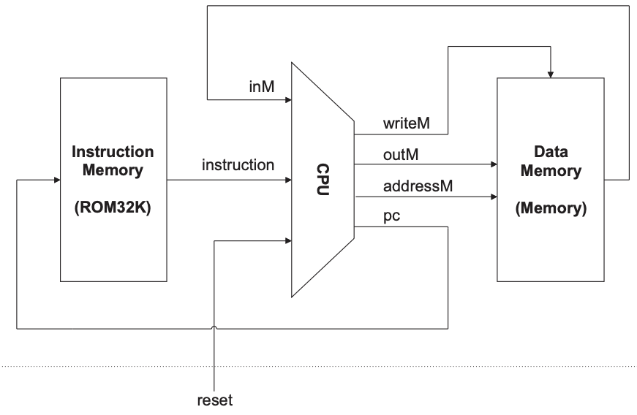
PART A
THE HACK COMPUTER
Let’s see what a hack computer is,
The Hack computer has a simpler architecture that allows newcomers to comprehend basic computing concepts. It is a 16-bit machine with a proprietary instruction set and a straightforward hardware design.
The Hack computer platform consists of a hardware emulator and the Hack Assembly assembly language.
They provide a hands-on experience that enables students to explore the inner workings of a computer and gain insights into key concepts like machine language, computer organization, and programming.
Components of Hack computer:
Memory(Data & Instruction Memory)
External Input & Output(I/O)
Hack CPU
Let’s see briefly about each component,
Simple Hack computer architecture

Slide 5
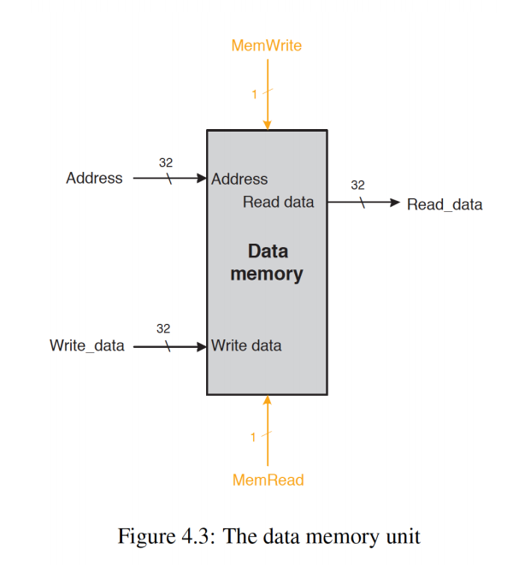
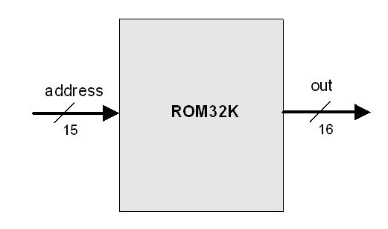
Project analysis slide 3
MEMORY
It is of two types:
DATA MEMORY
Data memory is a storage space in a computer system for variables, arrays, structures, and other data utilized by a programme.
Data memory is used when a programme is running to store values that are altered, modified, or accessed by the program's instructions.
INSTRUCTION MEMORY
In a computer system, instructions are often stored as binary code, which represents machine language instructions particular to the computer's architecture.
These instructions specify the actions the CPU will conduct, such as arithmetic computations, logical operations, memory access, and control flow.

Slide 6
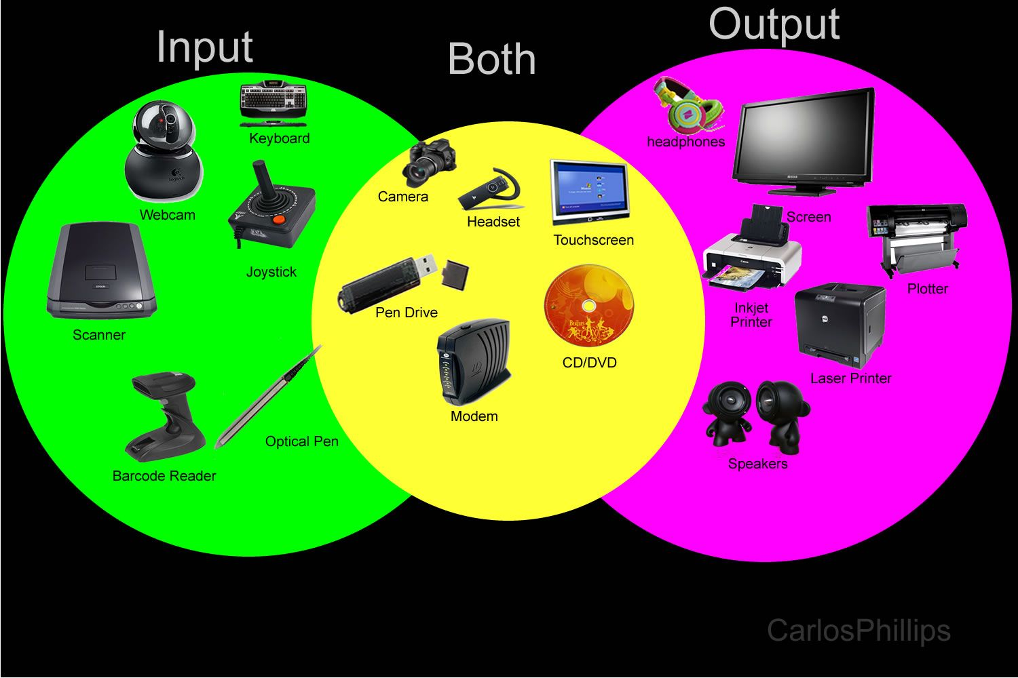
INPUT & OUTPUT
Here's a brief overview of the external input and output capabilities of the Hack computer:
External Input:
The Hack computer can take input from external devices, most notably a keyboard. When a user inputs on the keyboard, the input is sent to the Hack computer, which can then process and reply to the input.
External Output:
The Hack computer may output to external devices, most notably a screen or display. The output of a computer is often visual information presented on the screen, allowing users to observe the outcomes of programme execution or other desired output.

Slide 7
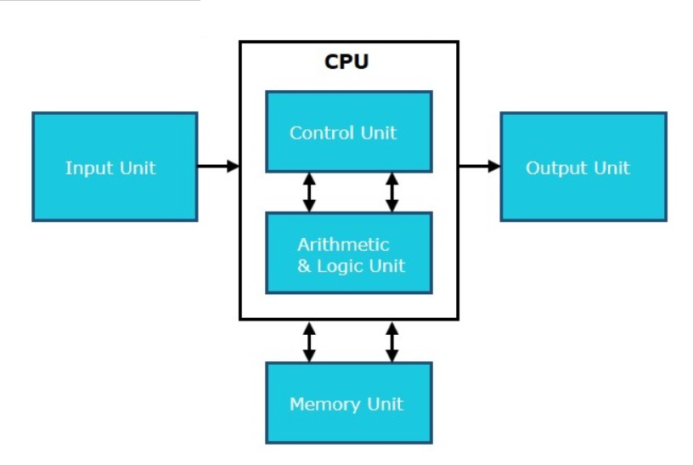
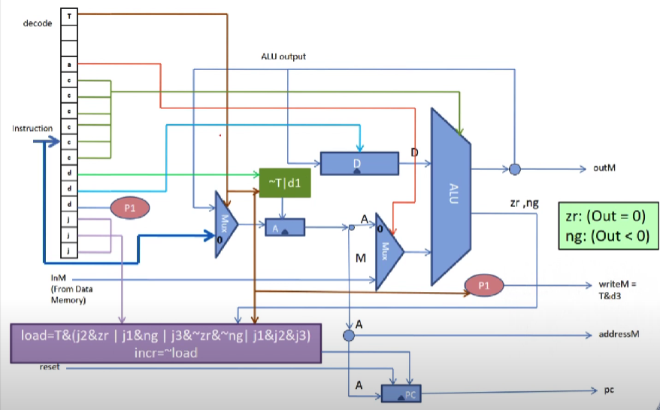
Hack CPU
CPU itself has following three components:
Memory or Storage unit:
It is also known as internal storage unit or the main memory or the primary storage or Random Access Memory (RAM).
Components
of CPU
Control unit:
This unit controls the operations of all parts of the computer but does not carry out any actual data processing operations.
ALU(Arithmetic Logic Unit:
This unit consists of two subsections namely,
Arithmetic Section
Logic Section
Block diagram of CPU

Slide 8
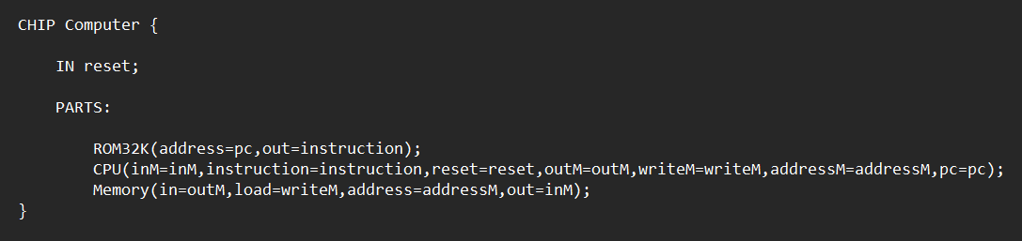
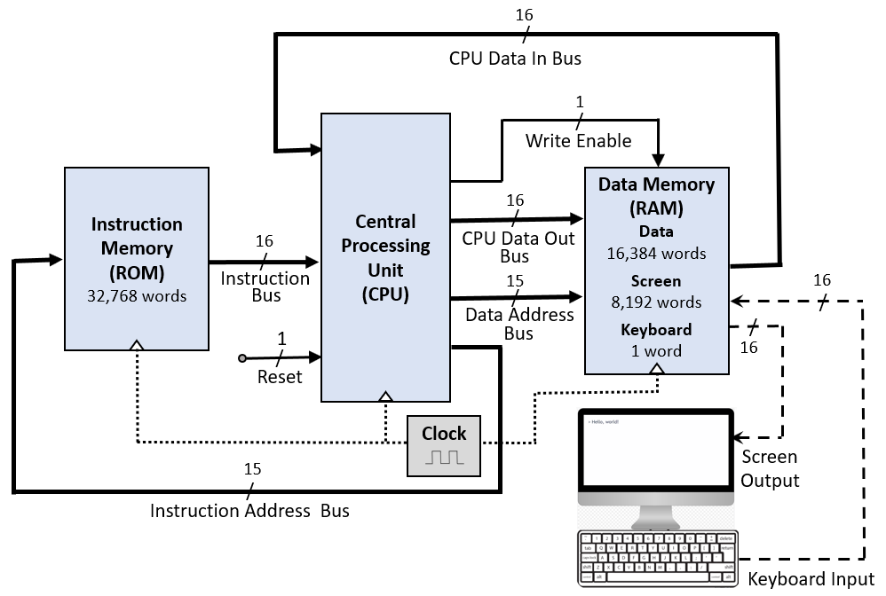
HDL code
This is how Hack CPU works

Slide 9

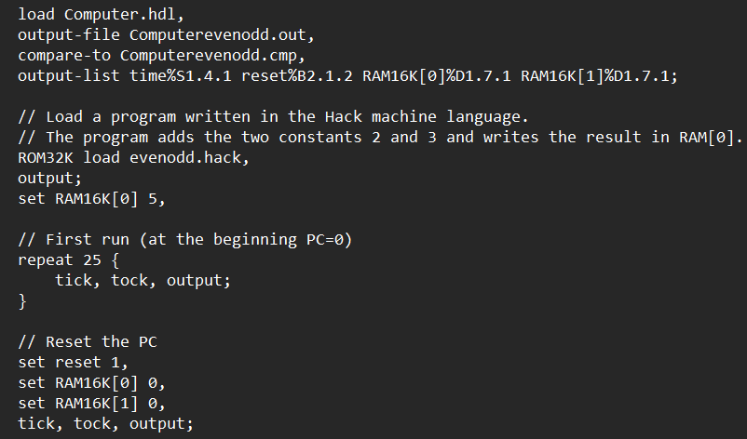
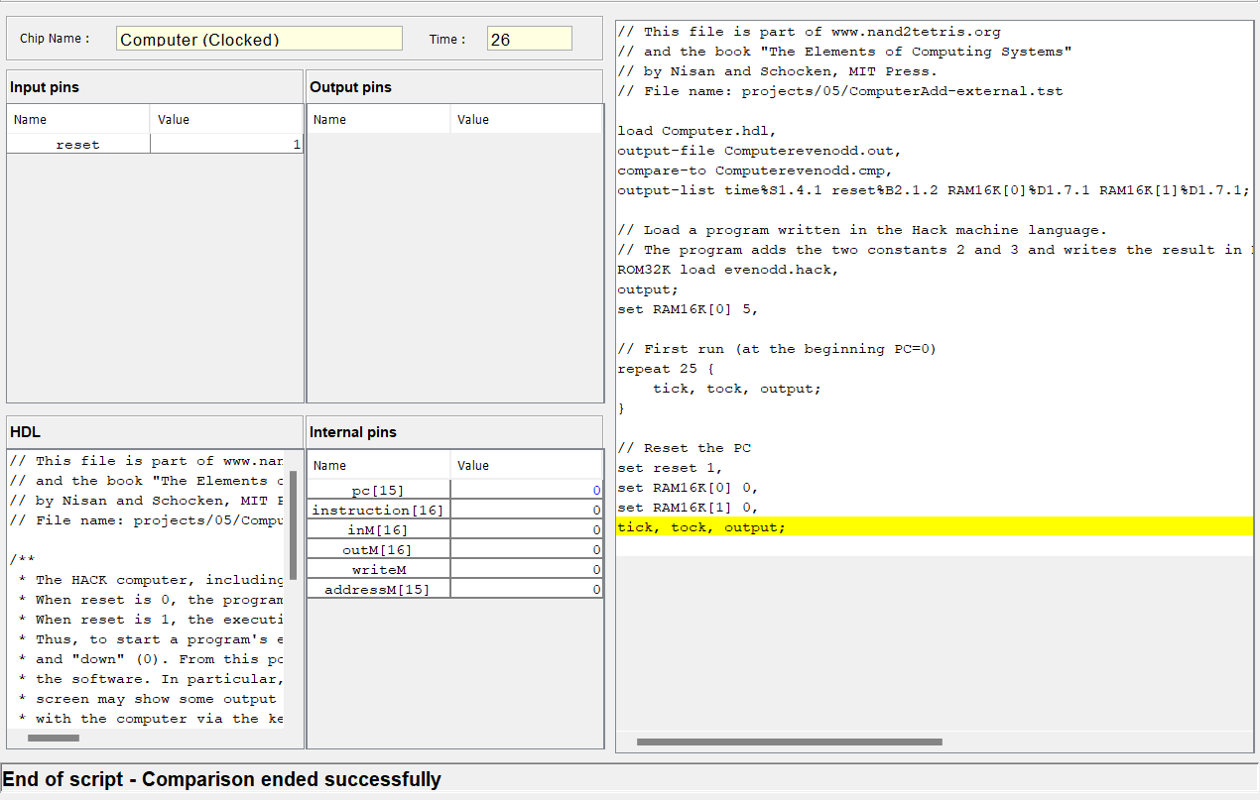
Test script
We have built a test script for finding whether a number is even or odd
TST
Output test

Slide 10

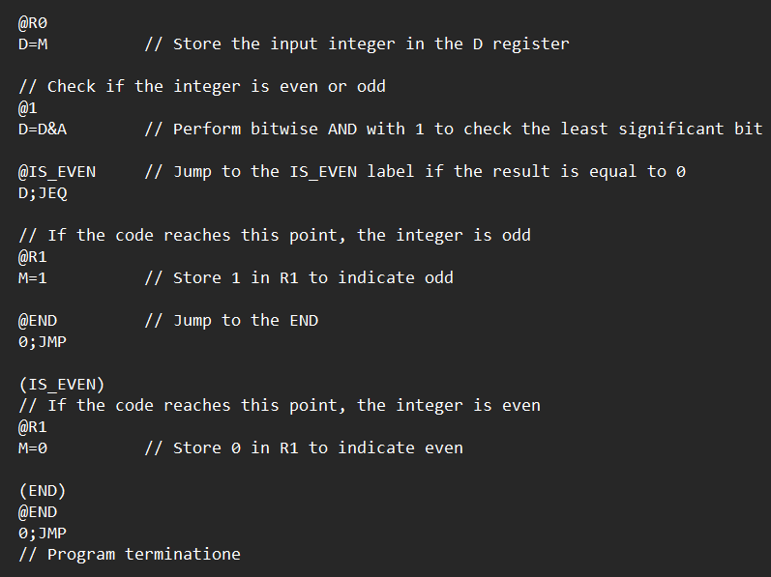
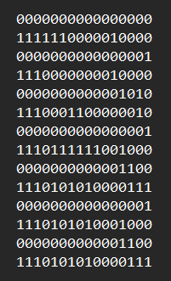
Asm & Hack file
Hack code to find whether a number is even or odd
.Hack
.Asm

Slide 11
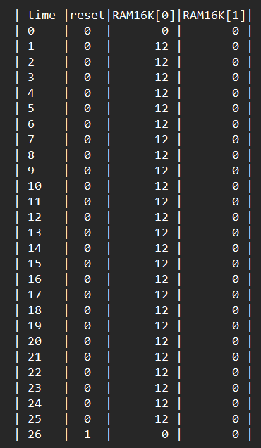
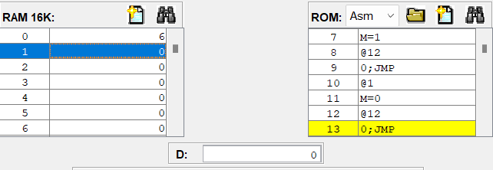

Output for Even
For an even number (both positive and negative) the output will be zero(0)
+Ve →
Generated Output file
-Ve →

Slide 12
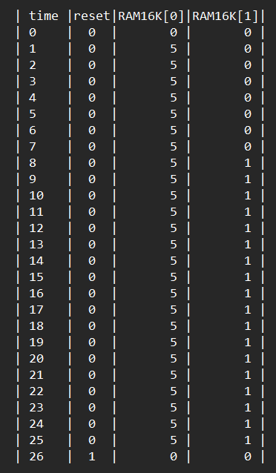
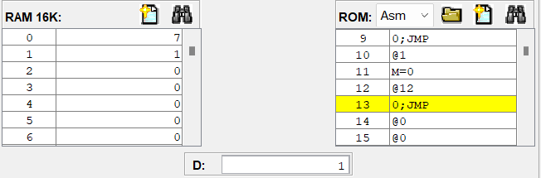
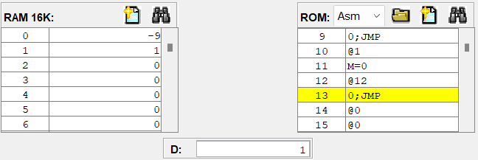
Output for Odd
For odd number (both positive and negative) the output will be zero(0)
+Ve →
Generated Output file
-Ve →

Slide 13
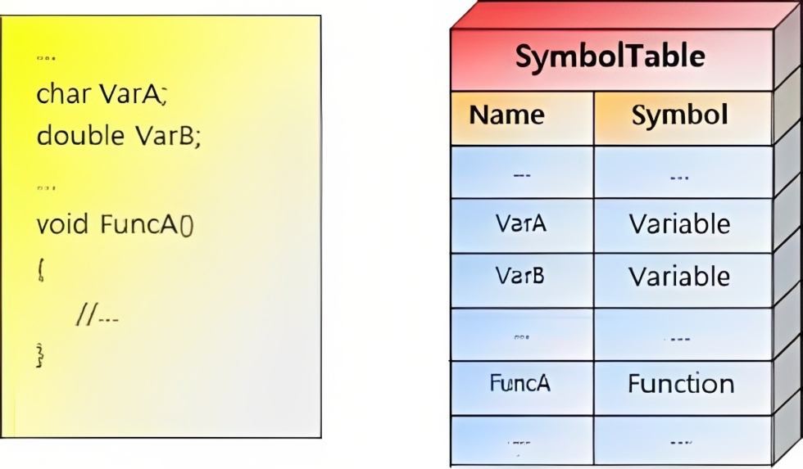
PART B
What is SYMBOL TABLE ??
It is an important data structure in computer language compilers and interpreters. It serves as a database for locating and storing variables, constants, and other forms of programme identifiers.
It facilitates efficient identifier lookup, allowing quick retrieval of attributes like type and role (reserved word, variable name, type name, procedure name).
What is JACK ?
Fictional High-Level Programming Language
Helps in the construction of a complete computer system, starting from a high-level language down to machine-level execution
Jack incorporates object-oriented programming principles

Slide 14
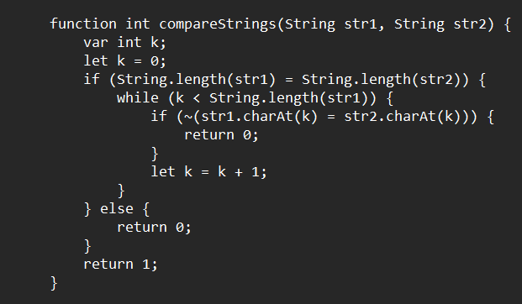
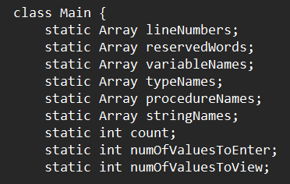
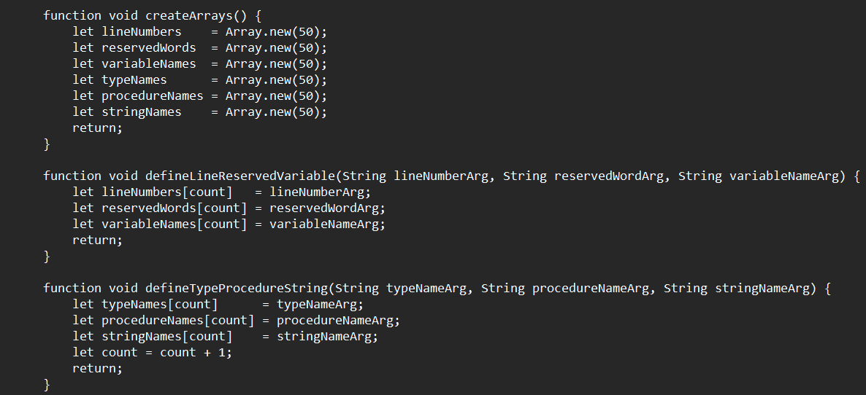
CODE
Declaring array’s and
variables
Comparing the length of two strings and each letter in the word
→
→
Creating arrays with size 50
Creating strings using functions
→

Slide 15
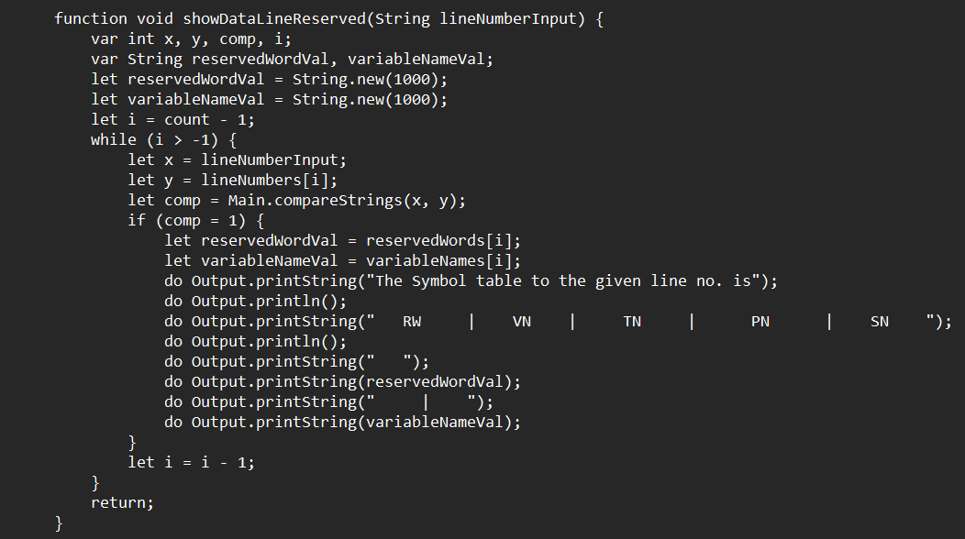
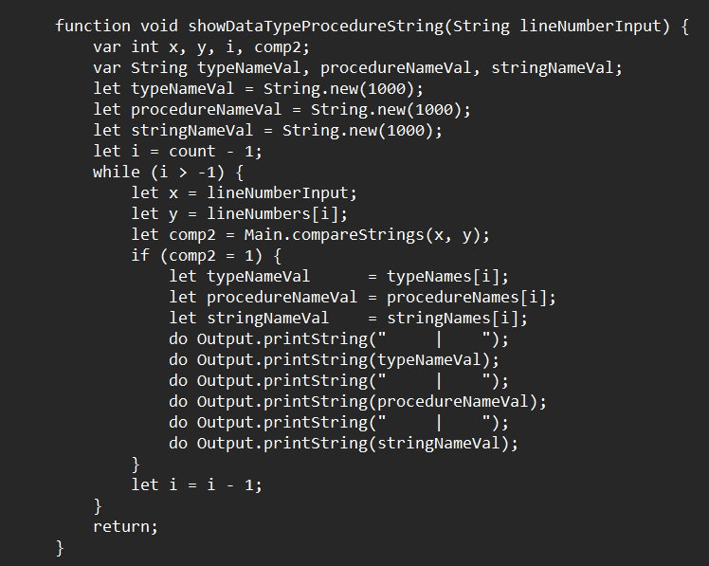
CODE
Creating Symbol table for
Reserved word
Variable name
→
Creating Symbol table for
Type name
Procedure name
String name
→

Slide 16
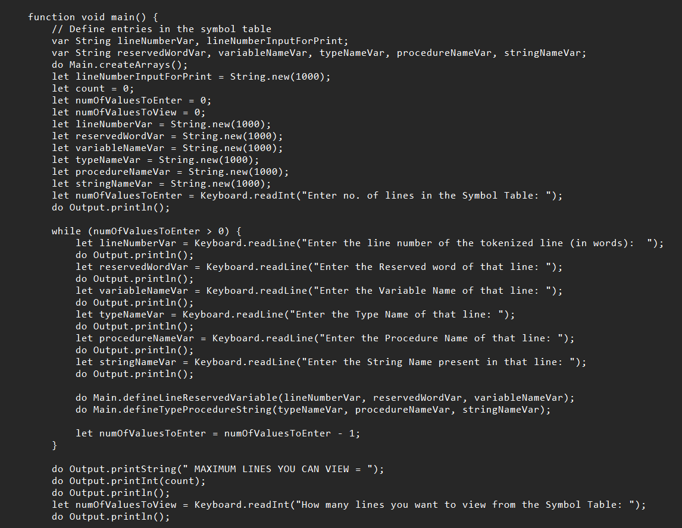
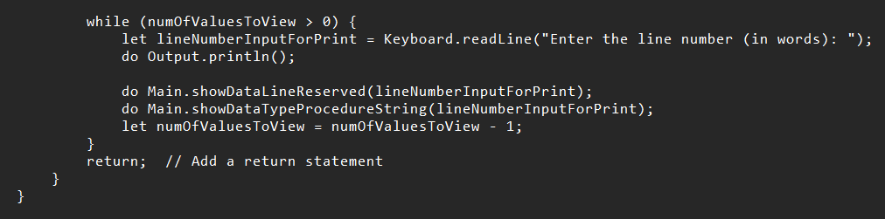
CODE
In main function we declare some variables and take input from the user
We call the functions which we defined
While loop runs until the given condition is not satisfied
Finally, it returns the values which required for the symbol table

Slide 17
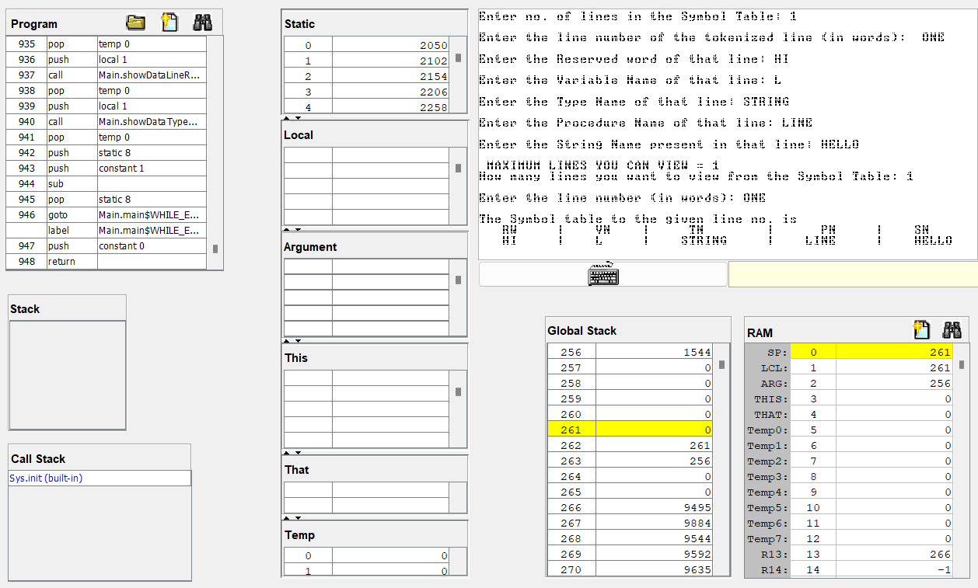
OUTPUT
When we compile the Jack code it is converted into VM code
We run the generated VM code using VM emulator

Slide 18
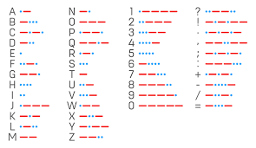
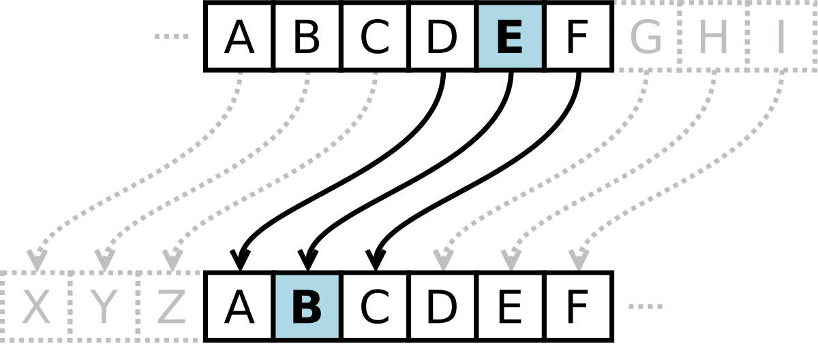
PART C
Encryption:
Encryption is the process of transforming plain, readable data (called plaintext) into coded or unreadable data (called ciphertext).
Decryption:
Decryption is the opposite of encryption. It is the process of returning encrypted or coded data (ciphertext) to its original, readable form (plaintext).
We are using two methods for Encryption & Decryption:
MORSE CODE
CAESER CIPHER
→
→

Slide 19
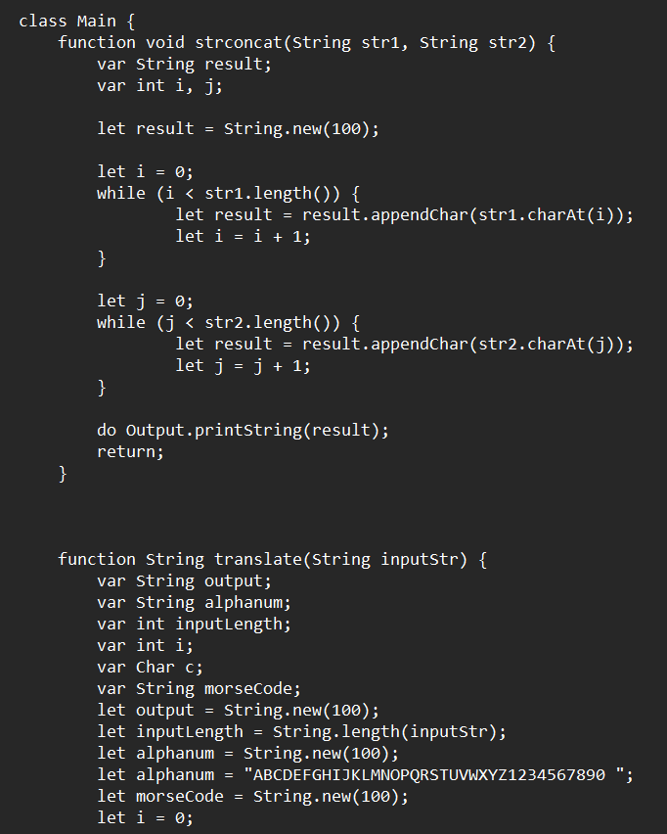
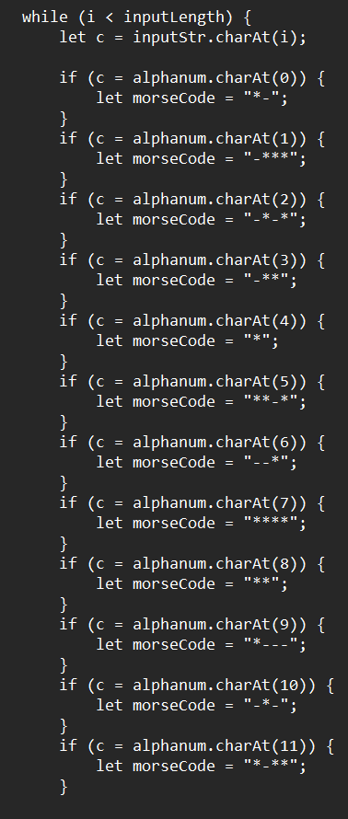
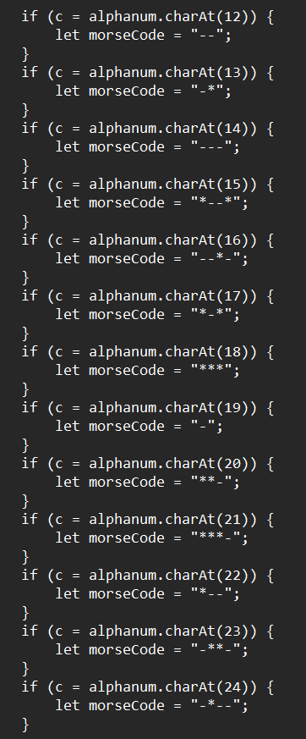
MORSE CODE : ENCRYPTION

Slide 20
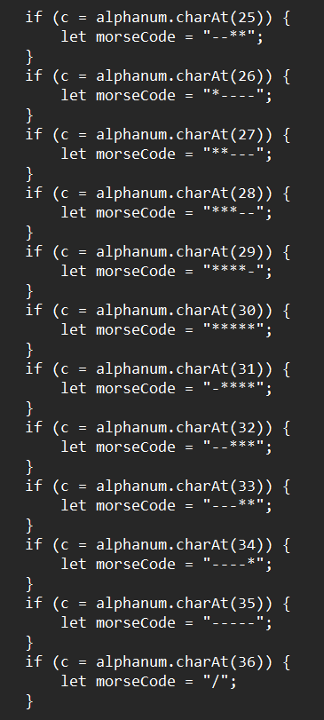
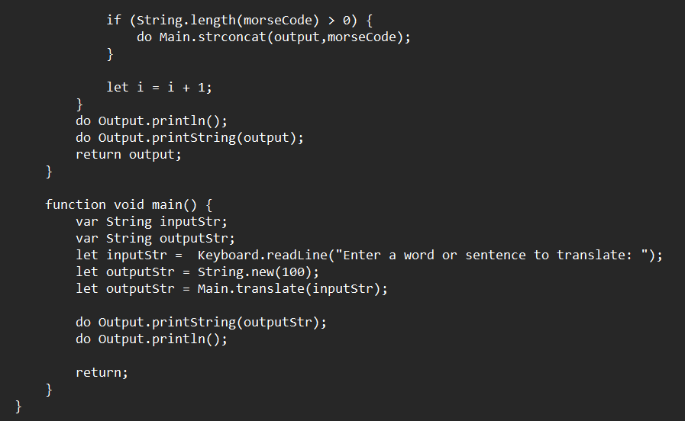
MORSE CODE : ENCRYPTION

Slide 21
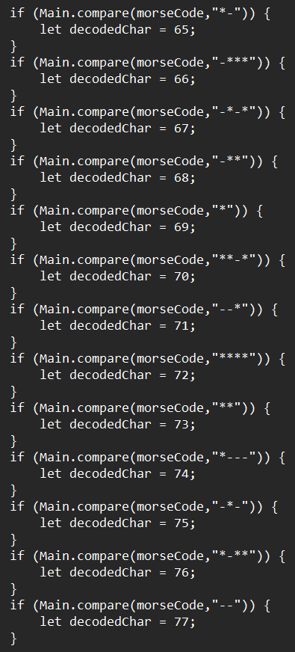
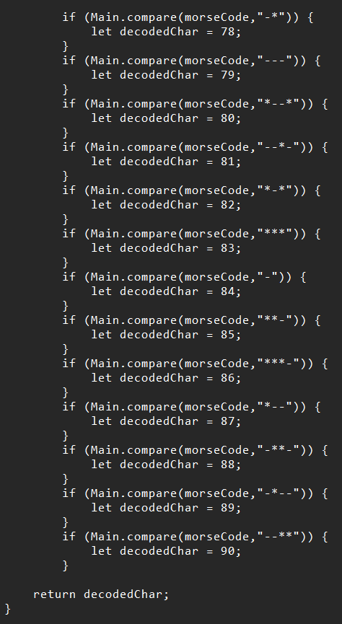
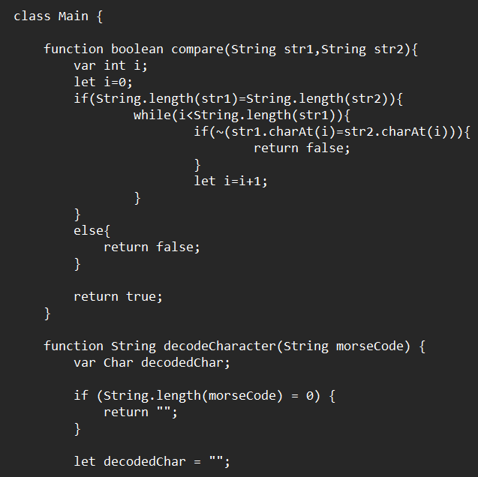
MORSE CODE : DECRYPTION

Slide 22
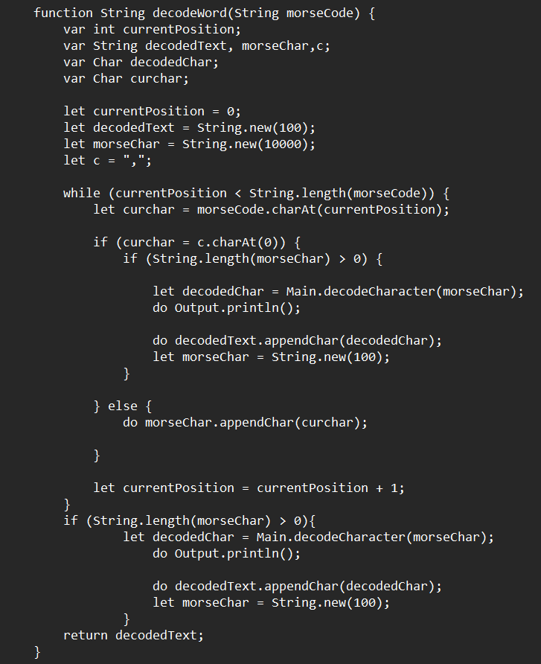
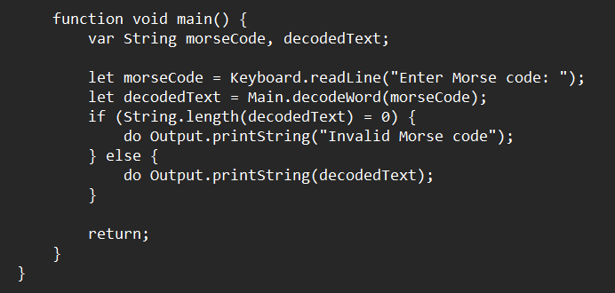
MORSE CODE : DECRYPTION

Slide 23
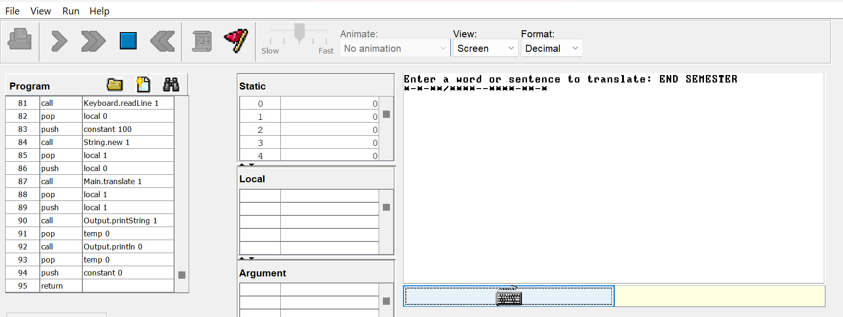
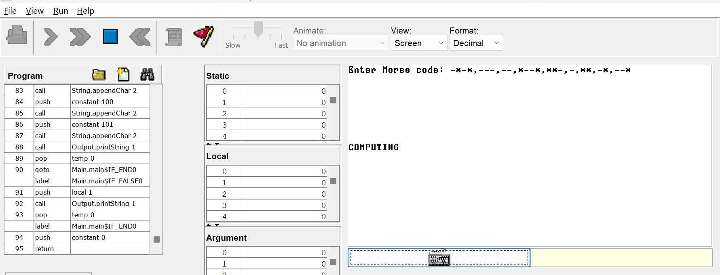
OUTPUT
→
ENCRYPTION
DECRYPTION →

Slide 24
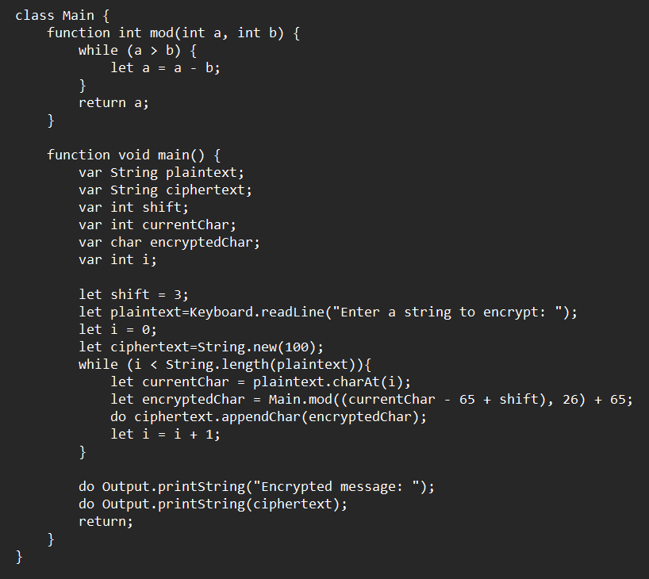
CAESER CIPHER: ENCRYPTION

Slide 25

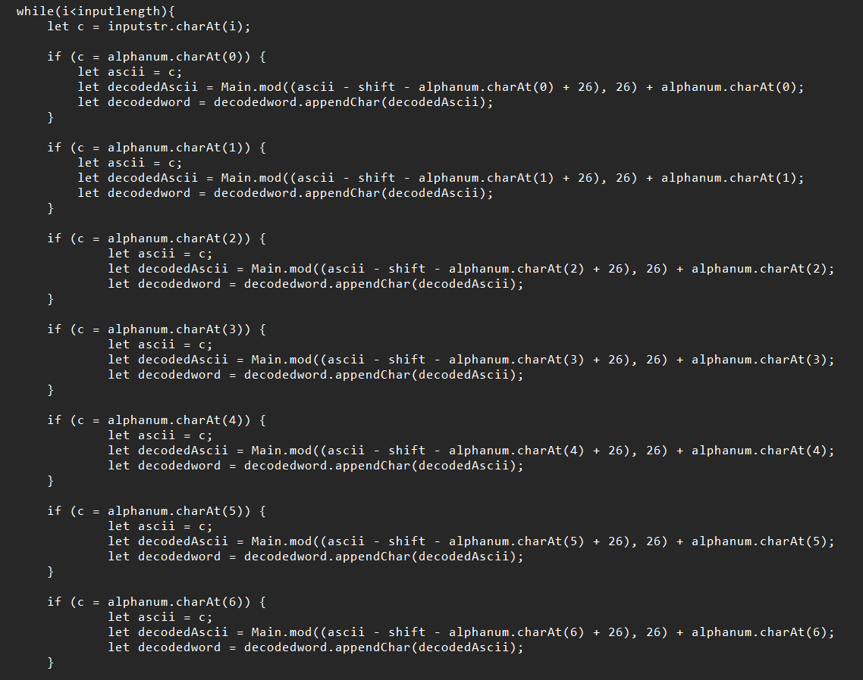
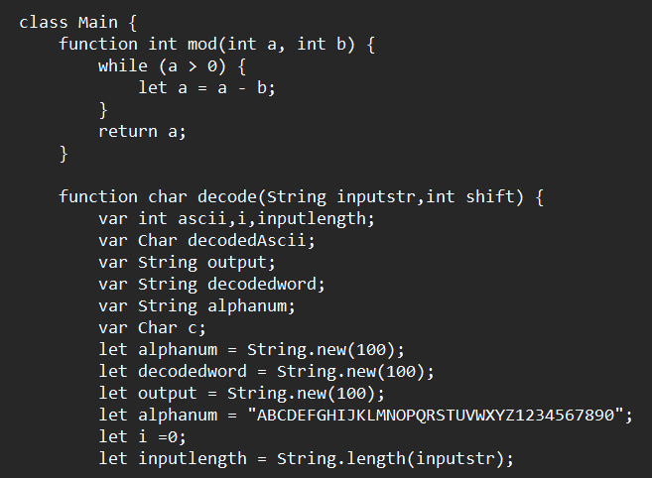
CAESER CIPHER: DECRYPTION

Slide 26
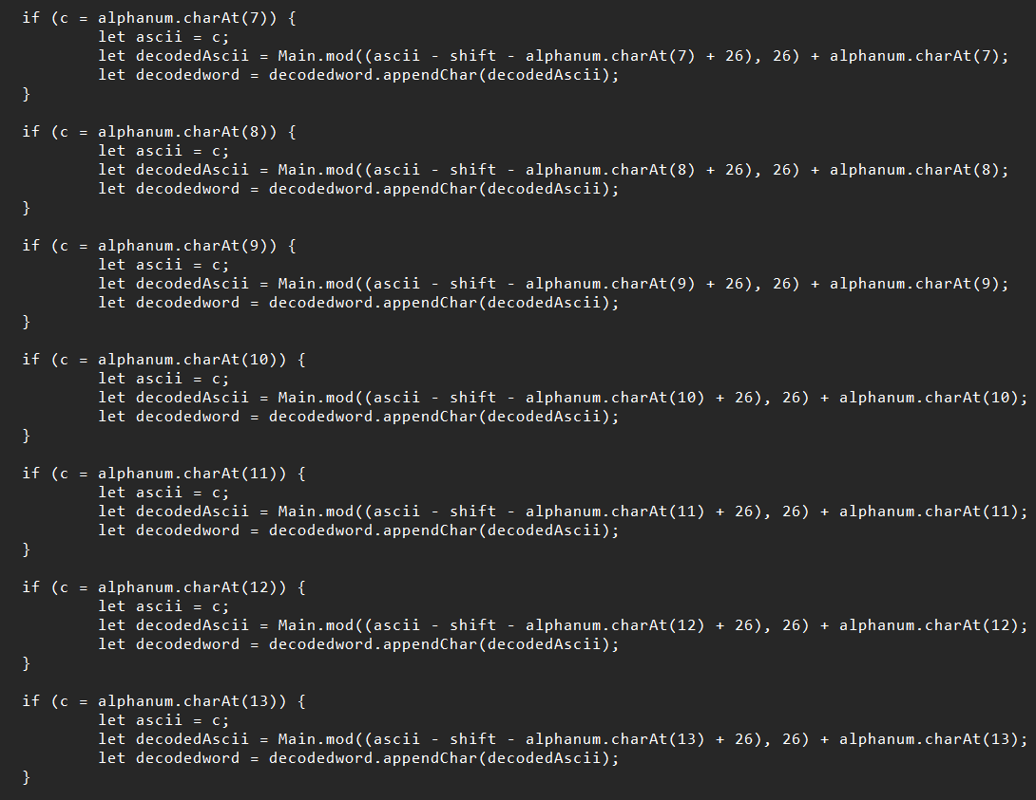
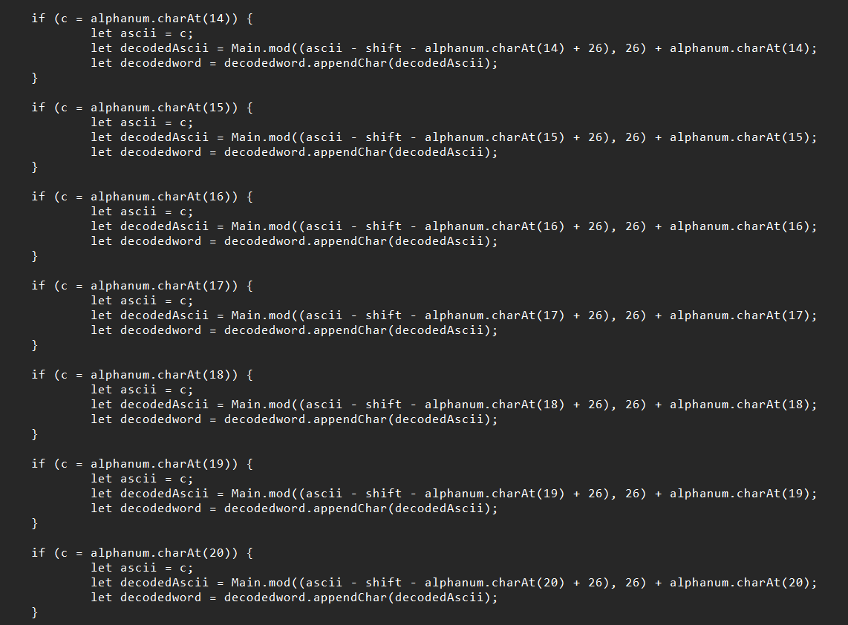
CAESER CIPHER: DECRYPTION

Slide 27
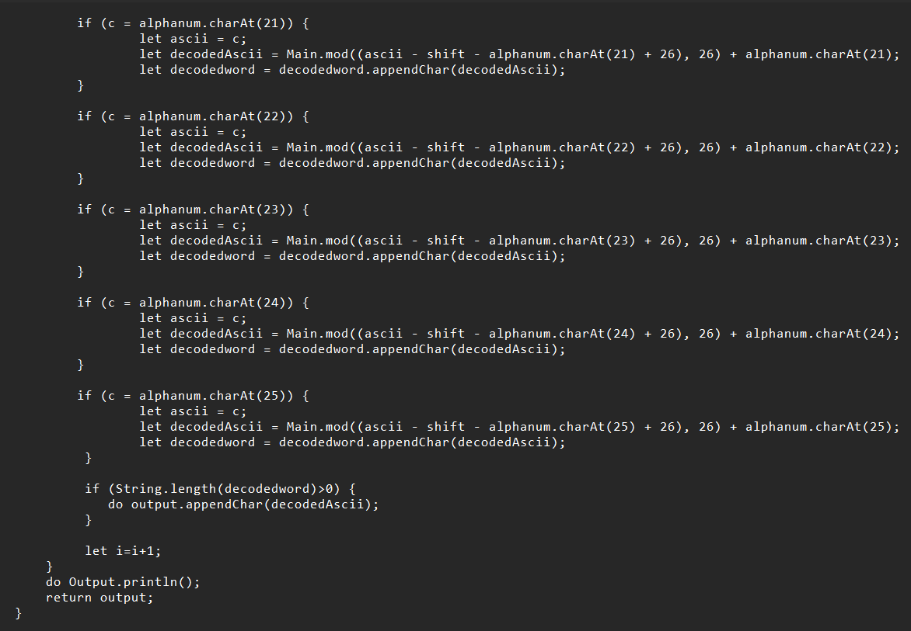
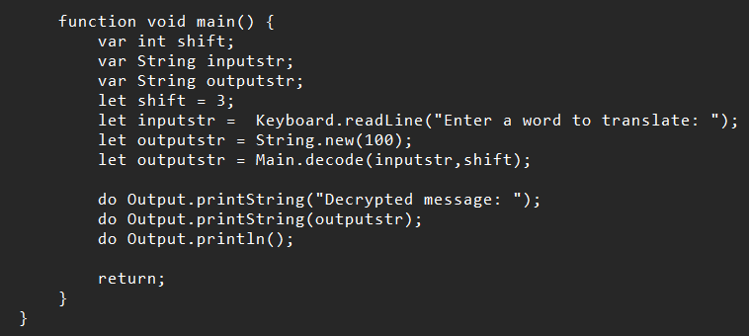
CAESER CIPHER: DECRYPTION

Slide 28
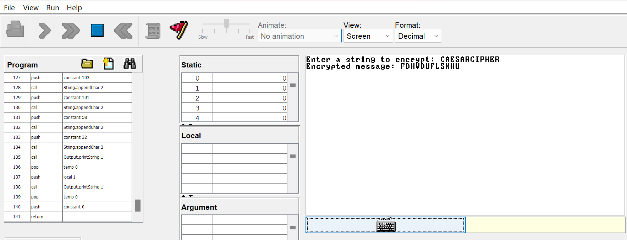
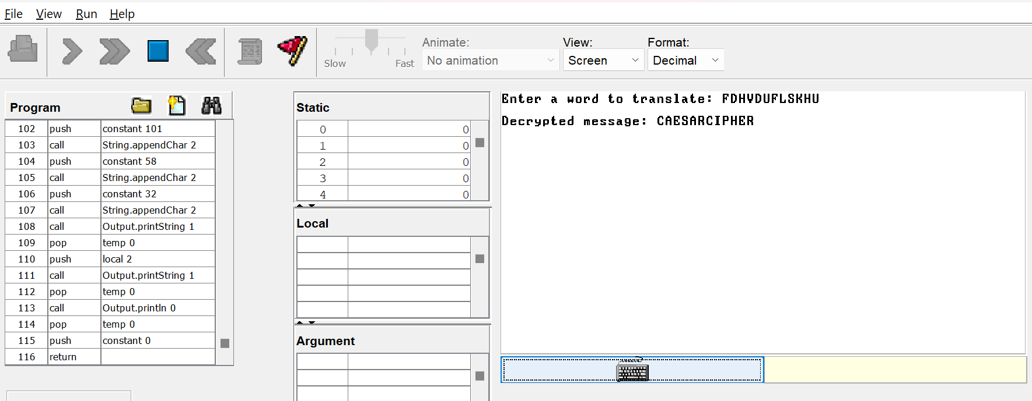
OUTPUT
→
ENCRYPTION
DECRYPTION →

Slide 29
Contributions
MITHIN
CB.EN.U4AIE22132
PART C - CAESER CIPHER: Encryption & Decryption
CHARAN
CB.EN.U4AIE22119
PART A - Computer Test script(odd/even)
PART B – type,procedure,string name and comparing two strings
1
2
PART B – reserved word, variable name, while loop
CB.EN.U4AIE22135
CHARISH
PART A – Computer.hdl code
PART C – MORSE CODE: Encryption & Decryption
CB.EN.U4AIE22156
VIKASH
4
3

Slide 30
Thank You

